Slide 1

Cognitive Computing
Dr. Piyush Joshi
Assistant Professor
IIIT Sri City

Slide 2


Slide 3
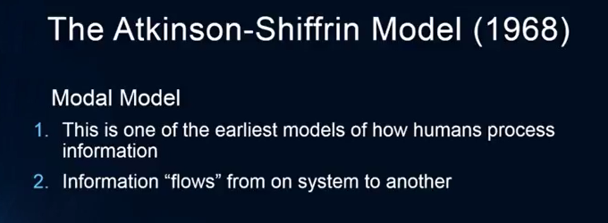
Most influential model of memory
Information Processing model

Slide 4
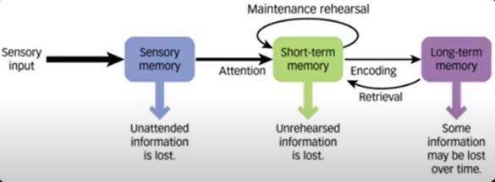
Atkinson–Shiffrin or Modal model

Slide 6
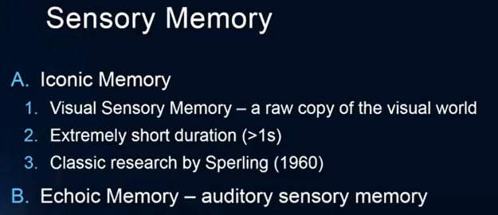

Slide 7
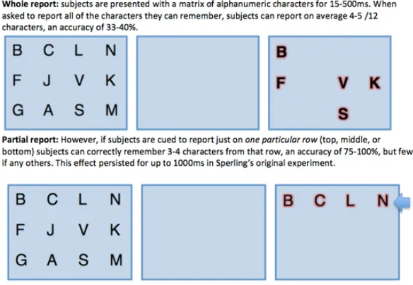
Sperling Experimentation

Slide 9

Sperling Experimentation

Slide 11
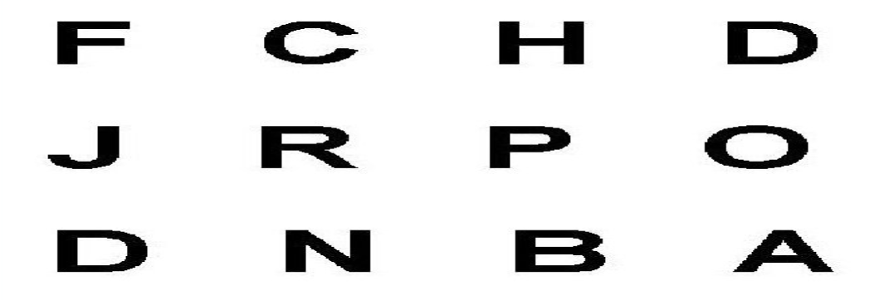
Sperling Experimentation

Slide 13

Sperling Experimentation

Slide 14
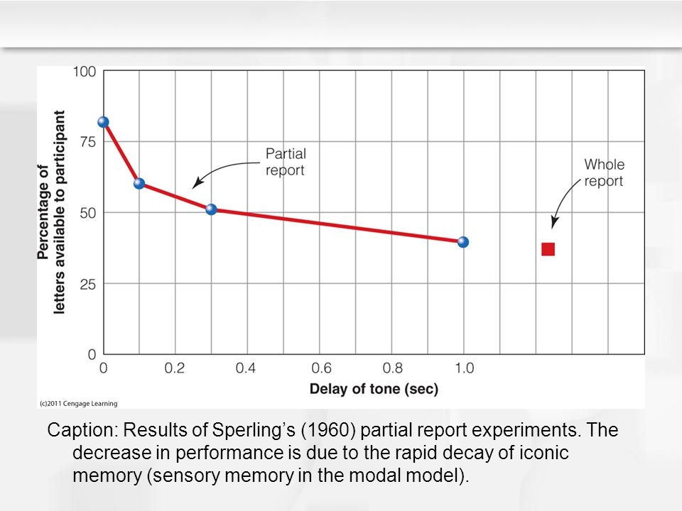

Slide 15
Short term memory

Slide 16
STM
Short-term memory, also known as primary or active memory, includes the information we are currently aware of or thinking about.
Most of the information kept in short-term memory will be stored for approximately 20 to 30 seconds.
Its capacity is also very limited.

Slide 17

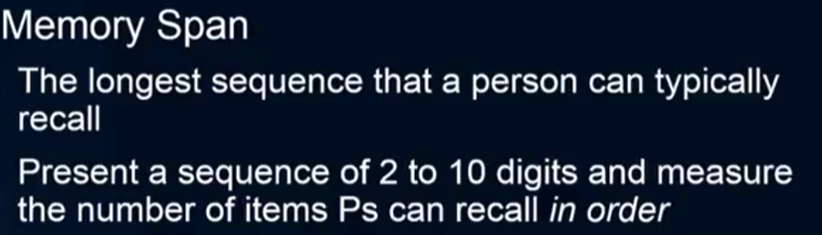

Slide 18
STM Capacity
George A. Miller (1956), when working at Bell Laboratories, conducted experiments showing that the store of short-term memory was 7±2 items (the title of his famous paper, "The magical number 7±2").
Modern estimates of the capacity of short-term memory are lower, typically of the order of 4–5 items; however, memory capacity can be increased through a process called chunking.
For example, in recalling a ten-digit telephone number, a person could chunk the digits into three groups: first, the area code (such as 123), then a three-digit chunk (456) and lastly a four- digit chunk (7890). This method of remembering telephone

Slide 19
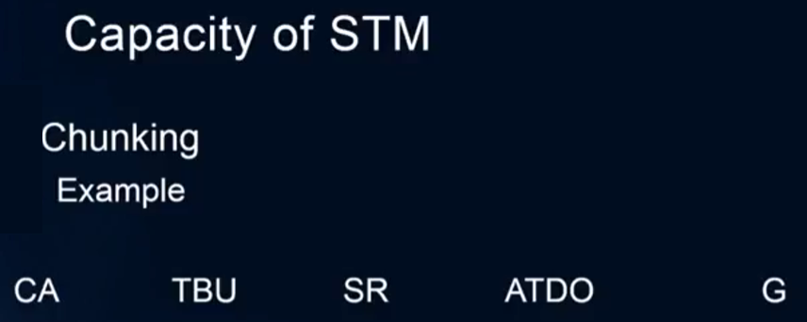

Slide 20


Slide 21
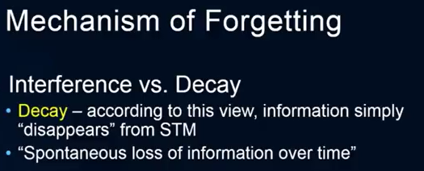

Slide 22
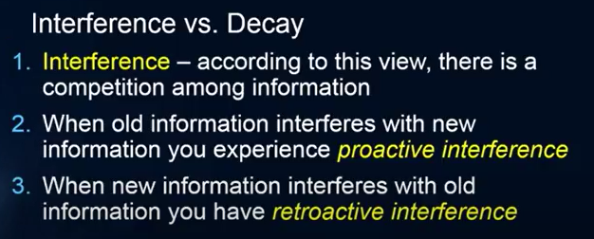

Slide 23
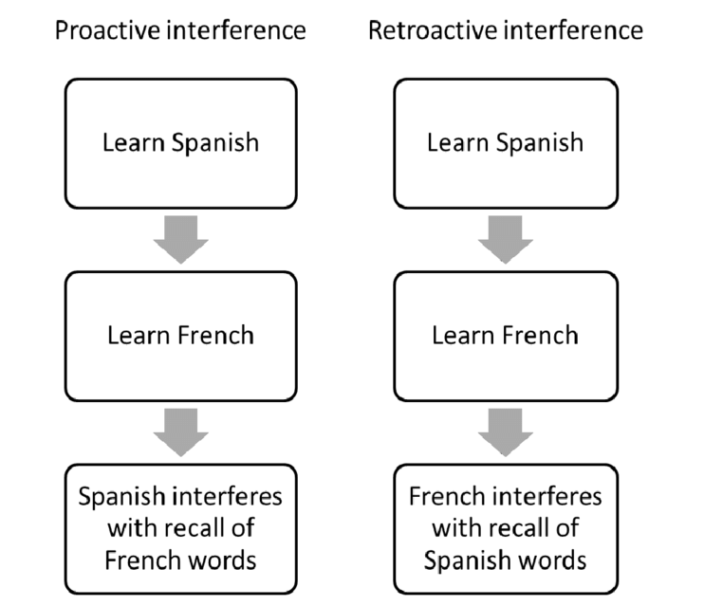

Slide 24
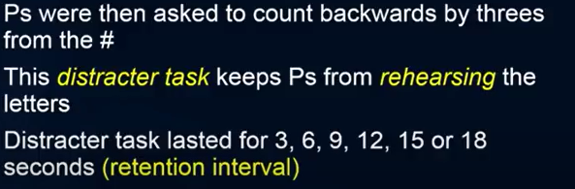
STM: Brown-Peterson Task

Slide 25
STM: Brown-Peterson Task
ZBA

Slide 26
STM: Brown-Peterson Task
367

Slide 27
STM: Brown-Peterson Task
PGL

Slide 28
STM: Brown-Peterson Task
597

Slide 29
STM: Brown-Peterson Task
DGA

Slide 30
STM: Brown-Peterson Task
223

Slide 31
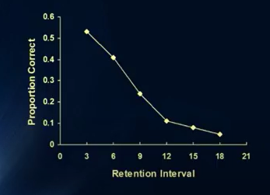
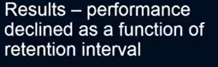
STM: Brown-Peterson Task

Slide 33
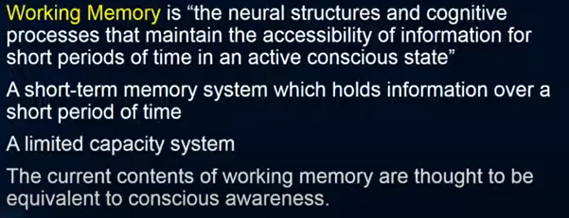
Working Memory

Slide 34
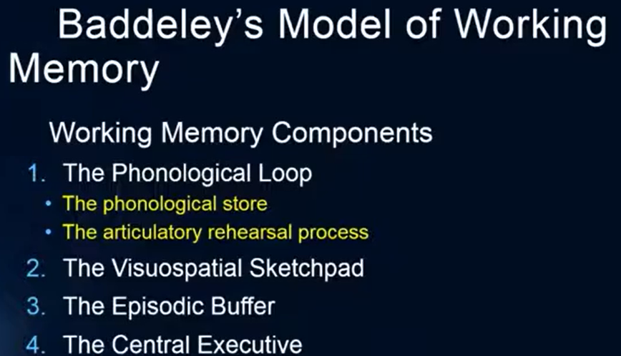
Working Memory

Slide 35
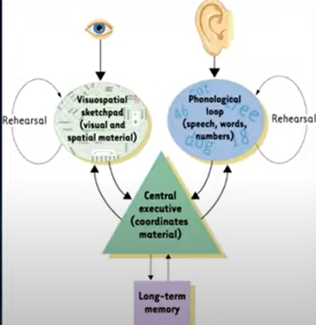

Slide 36
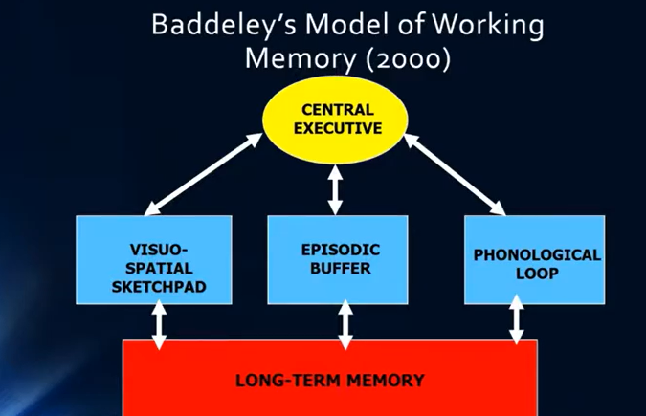

Slide 37
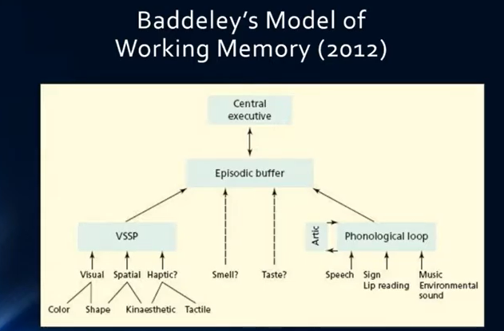

Slide 38
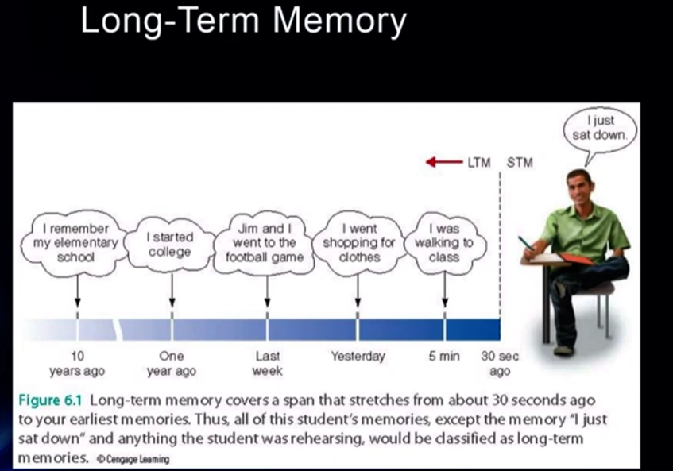

Slide 39
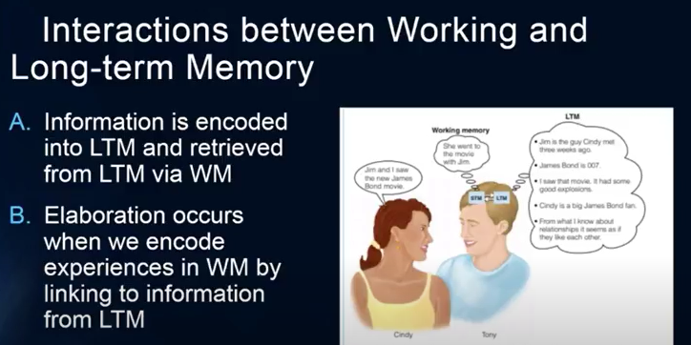
Long term memory
Long-term memory refers to the storage of information over an extended period. This type of memory tends to be stable and can last a long time—often for years.

Slide 40
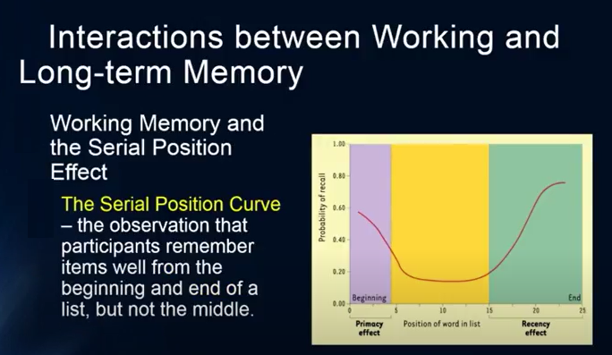
Long term memory

Slide 41
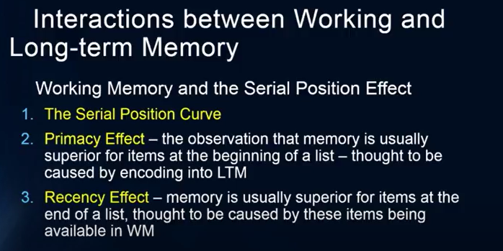
Long term memory

Slide 42
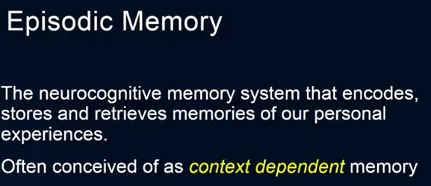
Types of LTM

Slide 43
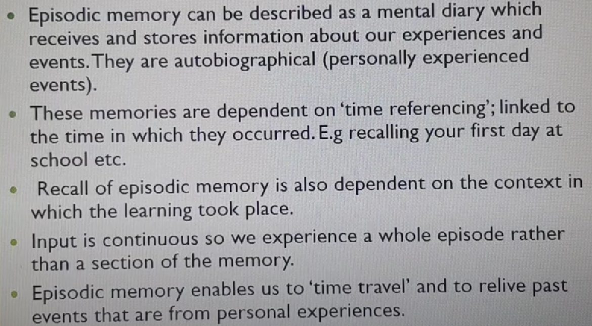
Episodic Memory

Slide 44
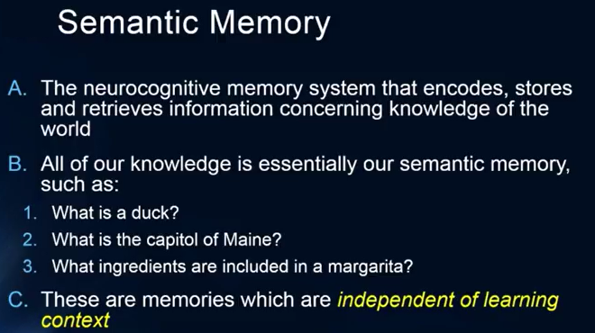
Types of LTM

Slide 45
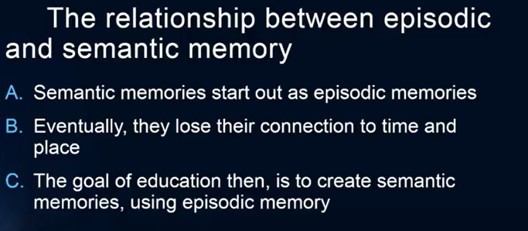

Slide 46
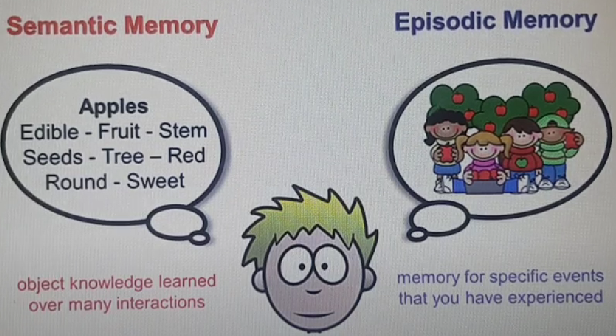

Slide 47
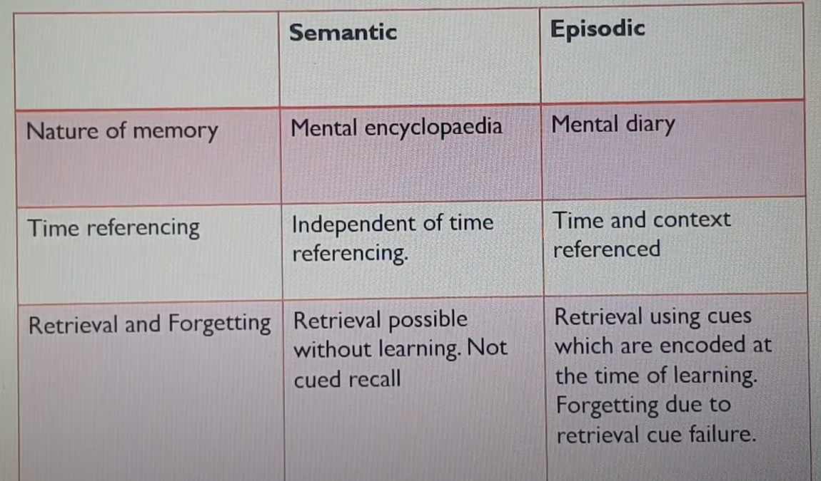
Semantic vs. Episodic

Slide 48
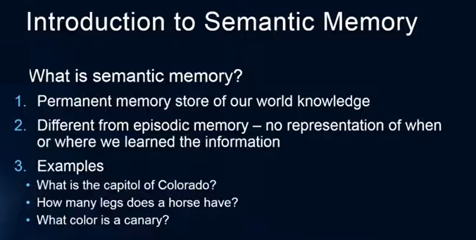
Semantic memory

Slide 49
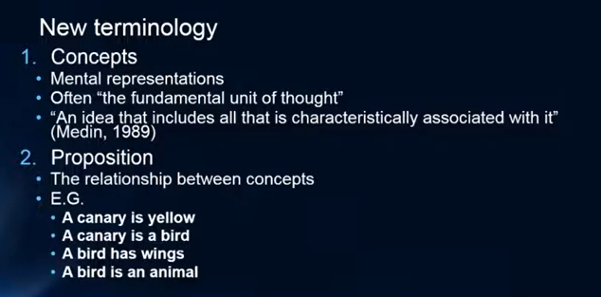
Semantic memory

Slide 50
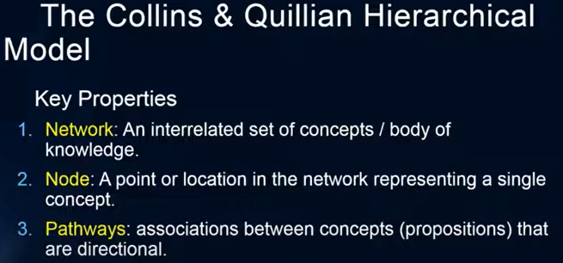
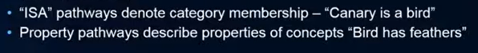
Semantic memory

Slide 51
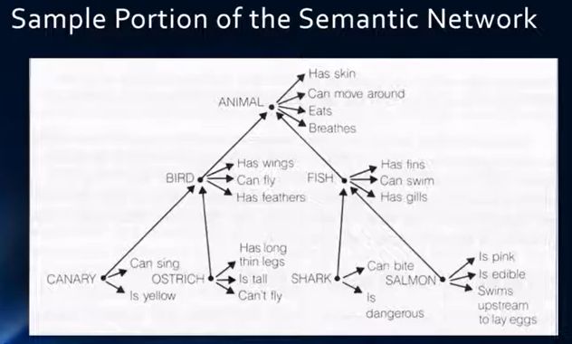
Semantic memory

Slide 52
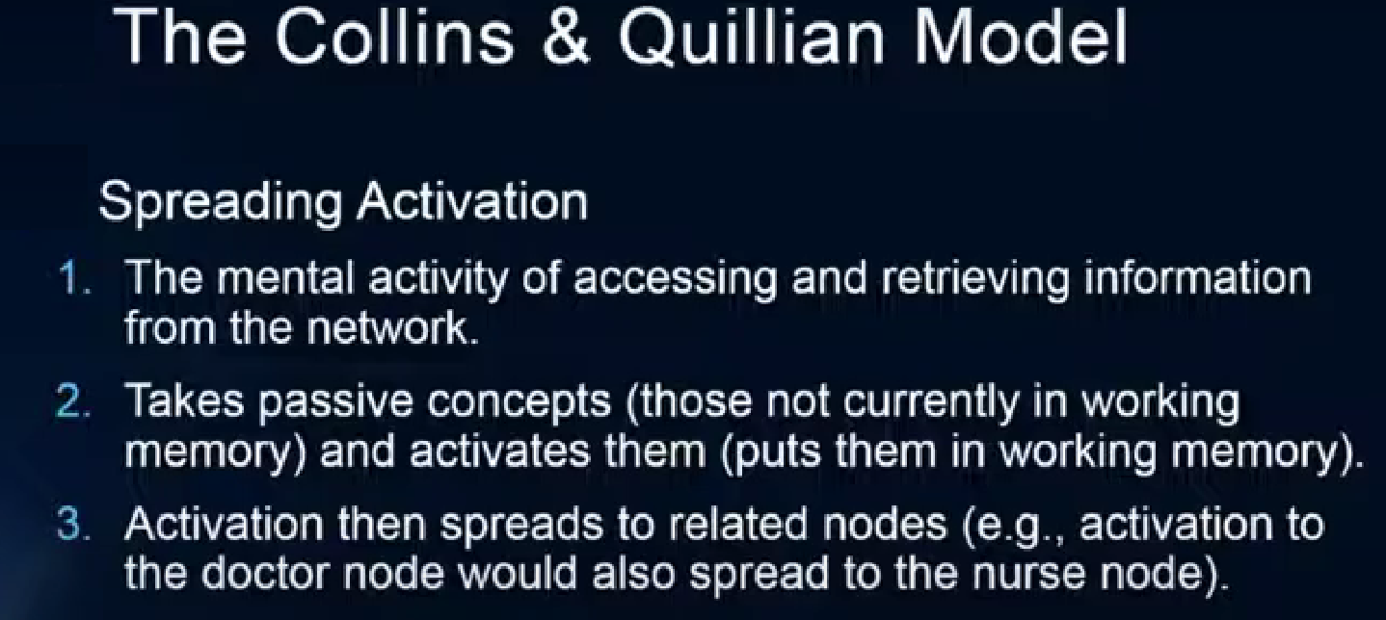
Semantic memory

Slide 53
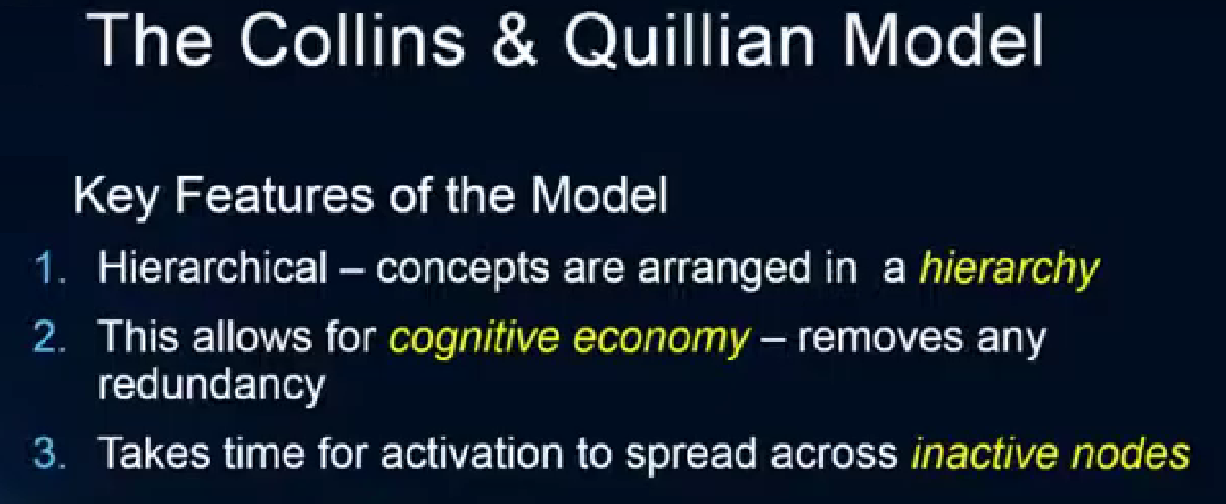
Semantic memory

Slide 54
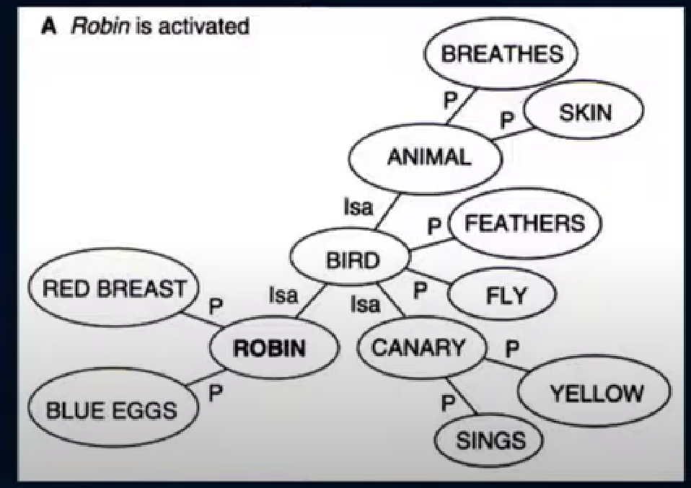
Semantic memory: Activation

